Slide 1
Protection Profile Program Update ‘score.exe’ v2.0 May 18, 2017

Slide 2
Background
The previous version of the auto-scorer, ‘score.exe’ v1.0, was designed to score each test case as though it only had one FLAW (or FIX). If the scanner tool ‘hit’ one or more times within a test case, the tool was given credit for only one hit (i.e. de-duplicated).
This is perfectly acceptable for the KDM (TRUE & FALSE) and Juliet (TRUE), but the Juliet (FALSE) test cases can contain multiple opportunities for hits (i.e. test cases within a test case)
Accurately counting the true number of unique hits (per opportunity) within each Juliet (FALSE) test case required a lot of effort, but v2.0 now solves this problem

Slide 3
Background (cont.)
The auto-scorer now logs every valid hit and writes it to a sheet (Hit Data) in the scorecard (Typical hit counts exceed 17K)
The Juliet (FALSE) one-to-one scoring method can be re-instated via. command-line argument if desired
The following screen shots show the scorecard produced by score.exe v2.0 for Suite 01 (C-Language)
The screenshots highlight the new, or enhanced, items added in v2.0

Slide 4
‘Summary’ Sheet

Slide 5
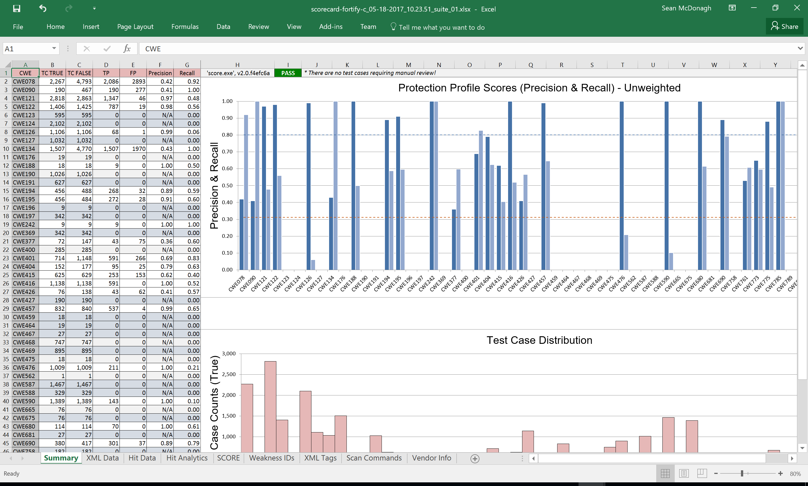
score.exe v2.0
These nine sheets will be discussed in the following slides

Slide 6
‘Summary’ Sheet
Items highlighted in gray have no hits but do have a Weakness ID provided by the vendor
Items highlighted in blue have no hits and do not have a Weakness ID provided by the vendor
The version number of the ‘score.exe’ application contains the 7-digit short hash (SHA-1) for the repository that tracks it (auto-calculated)
The overall ‘PASS’, ‘FAIL’ or ‘NEEDS REVIEW’ status is displayed here for the vendor
If there are any findings that are ambiguous, this message supplements the ‘NEEDS REVIEW’ status

Slide 7
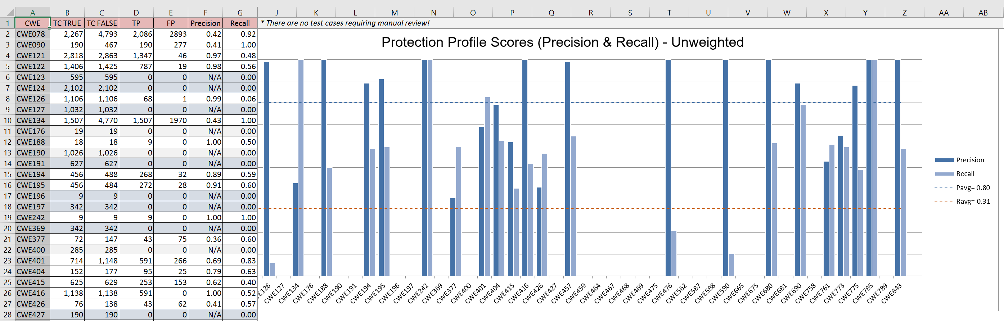
‘Summary’ Sheet (cont.)
This ‘Summary’ sheet contains the ‘Unweighted’ data and gives the vendor some insight into their results without necessarily having all of the scoring details
Test Case Count (TC) can be different for the TRUE and FALSE sets since we now recognize all Juliet (FALSE) opportunities
Precision and Recall are displayed per CWE for comparison purposes
Precision Average
Recall Average

Slide 8
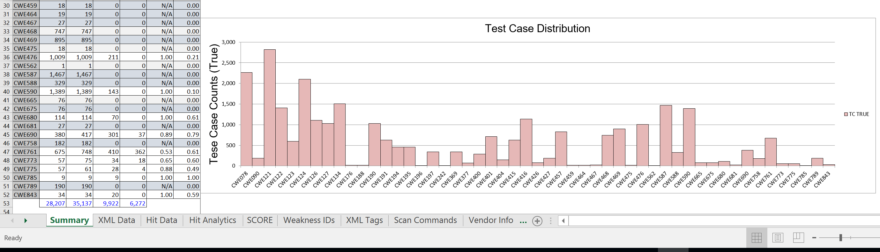
‘Summary’ Sheet (cont.)
Test Case distribution is also shown for reference
Totals for each category

Slide 9
‘XML Data’ Sheet

Slide 10
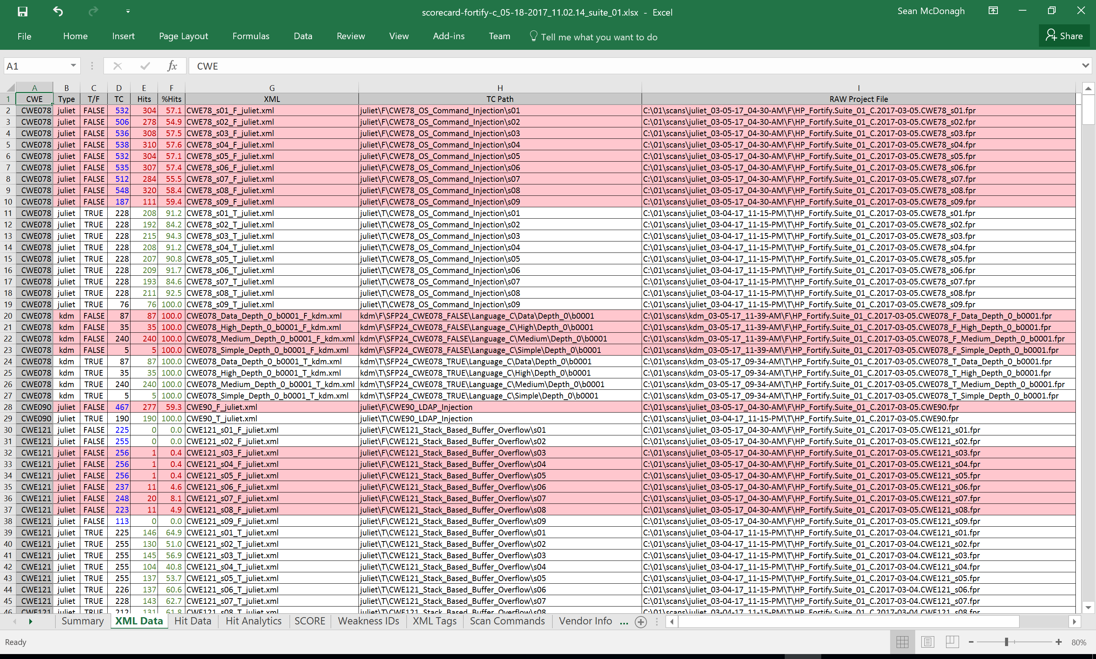
‘Summary’ Sheet

Slide 11
‘XML Data’ Sheet (cont.)
For this scan, multiple opportunities are enabled allowing all Juliet FALSE projects to have more opportunities than test cases. These special cases are highlighted in blue.
The ‘XML Data’ sheet contains each project that was scanned by the tool (Fortify in this case). For this scan, the ability to recognize all of the Juliet FALSE opportunities was enabled
Hits for FALSE test cases are considered to be False Positives and are highlighted in red
Hits for TRUE test cases are considered to be True Positives and are referenced in green

Slide 12
‘Hit Data’ Sheet

Slide 13
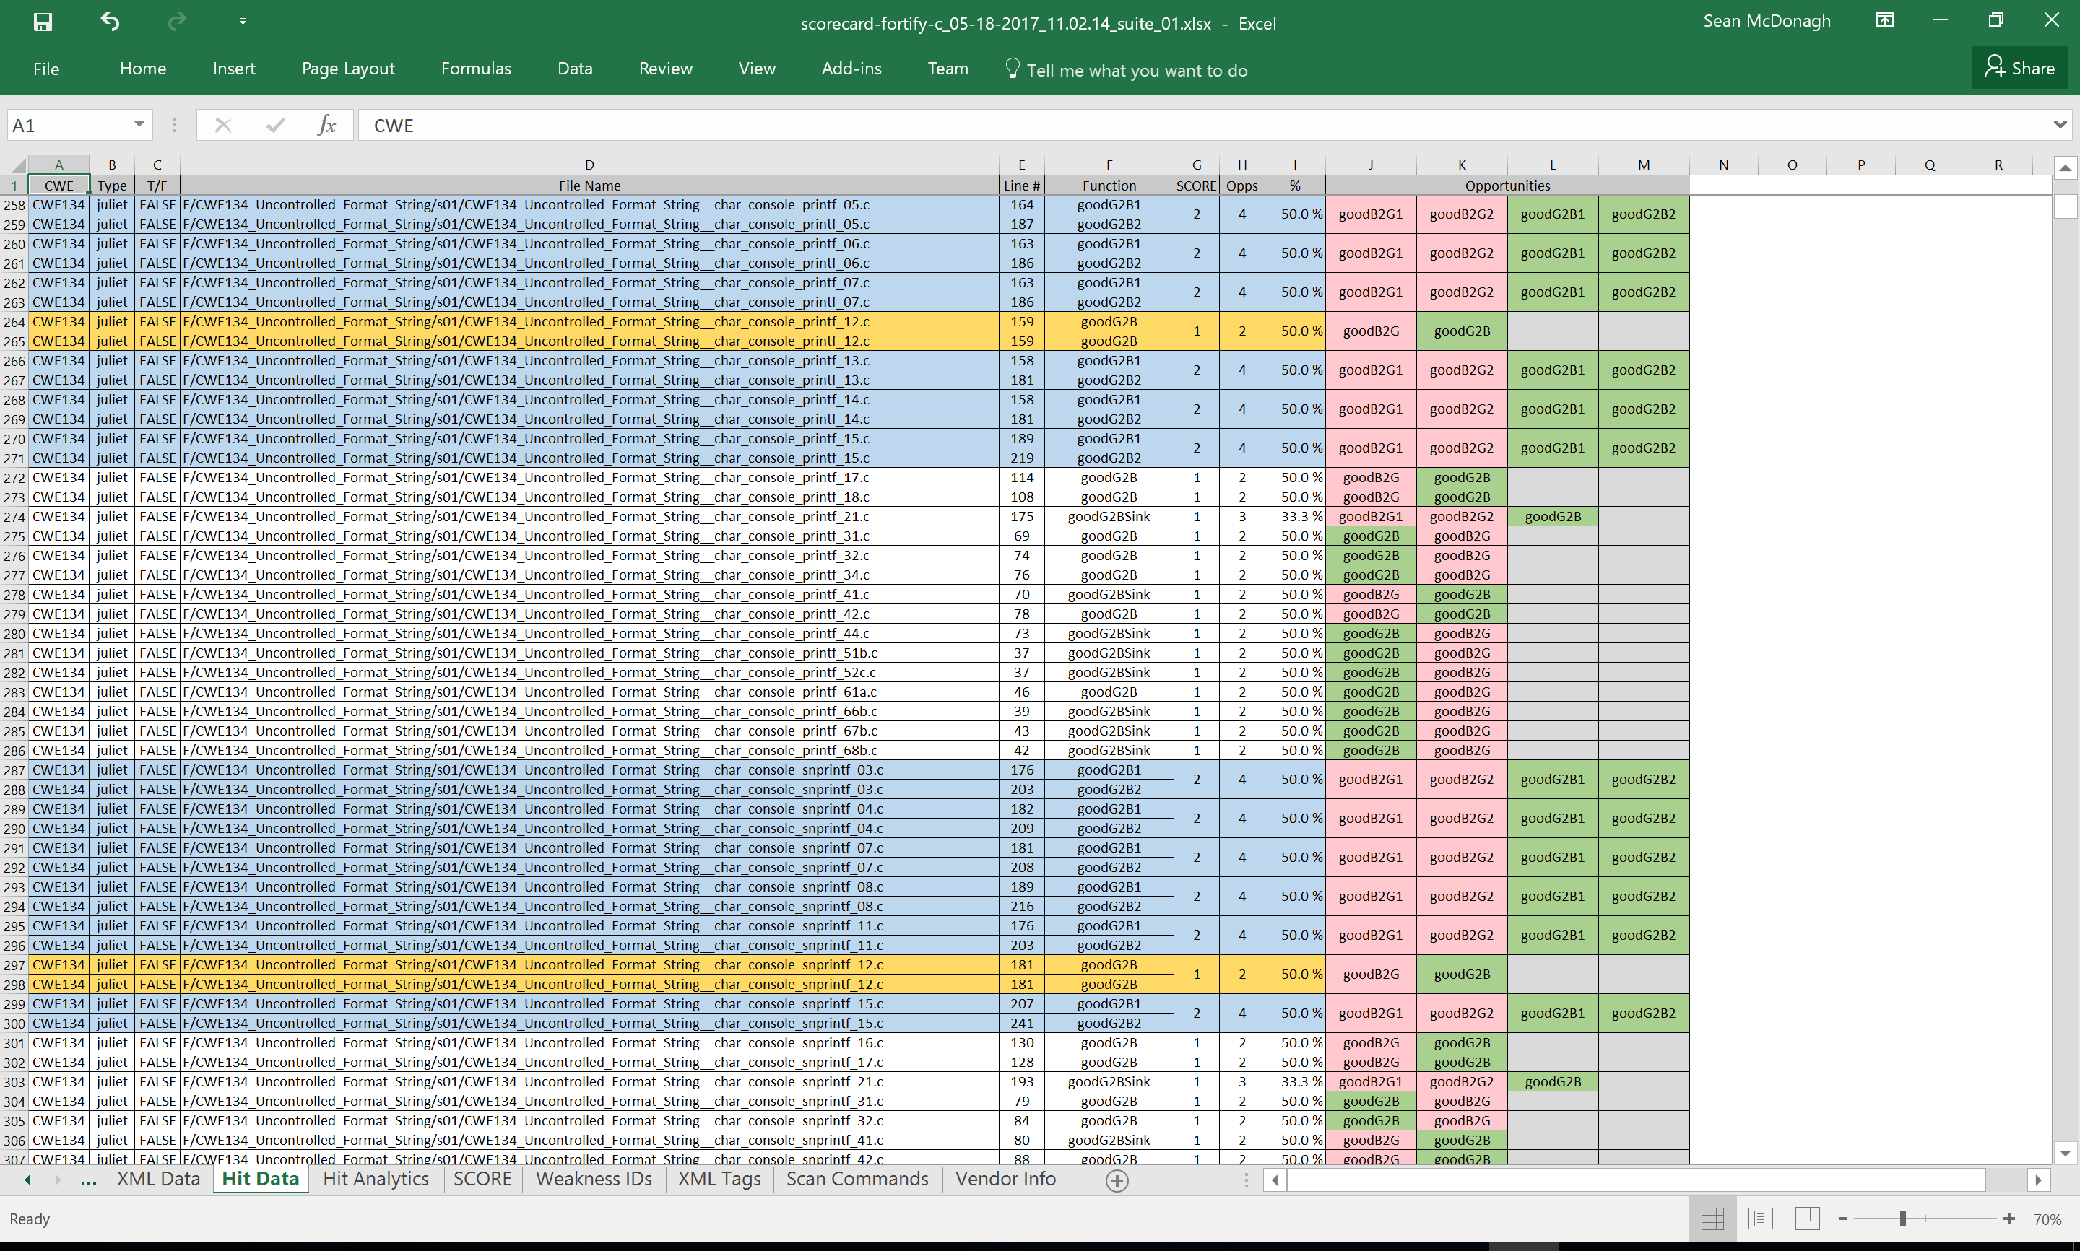

Slide 14
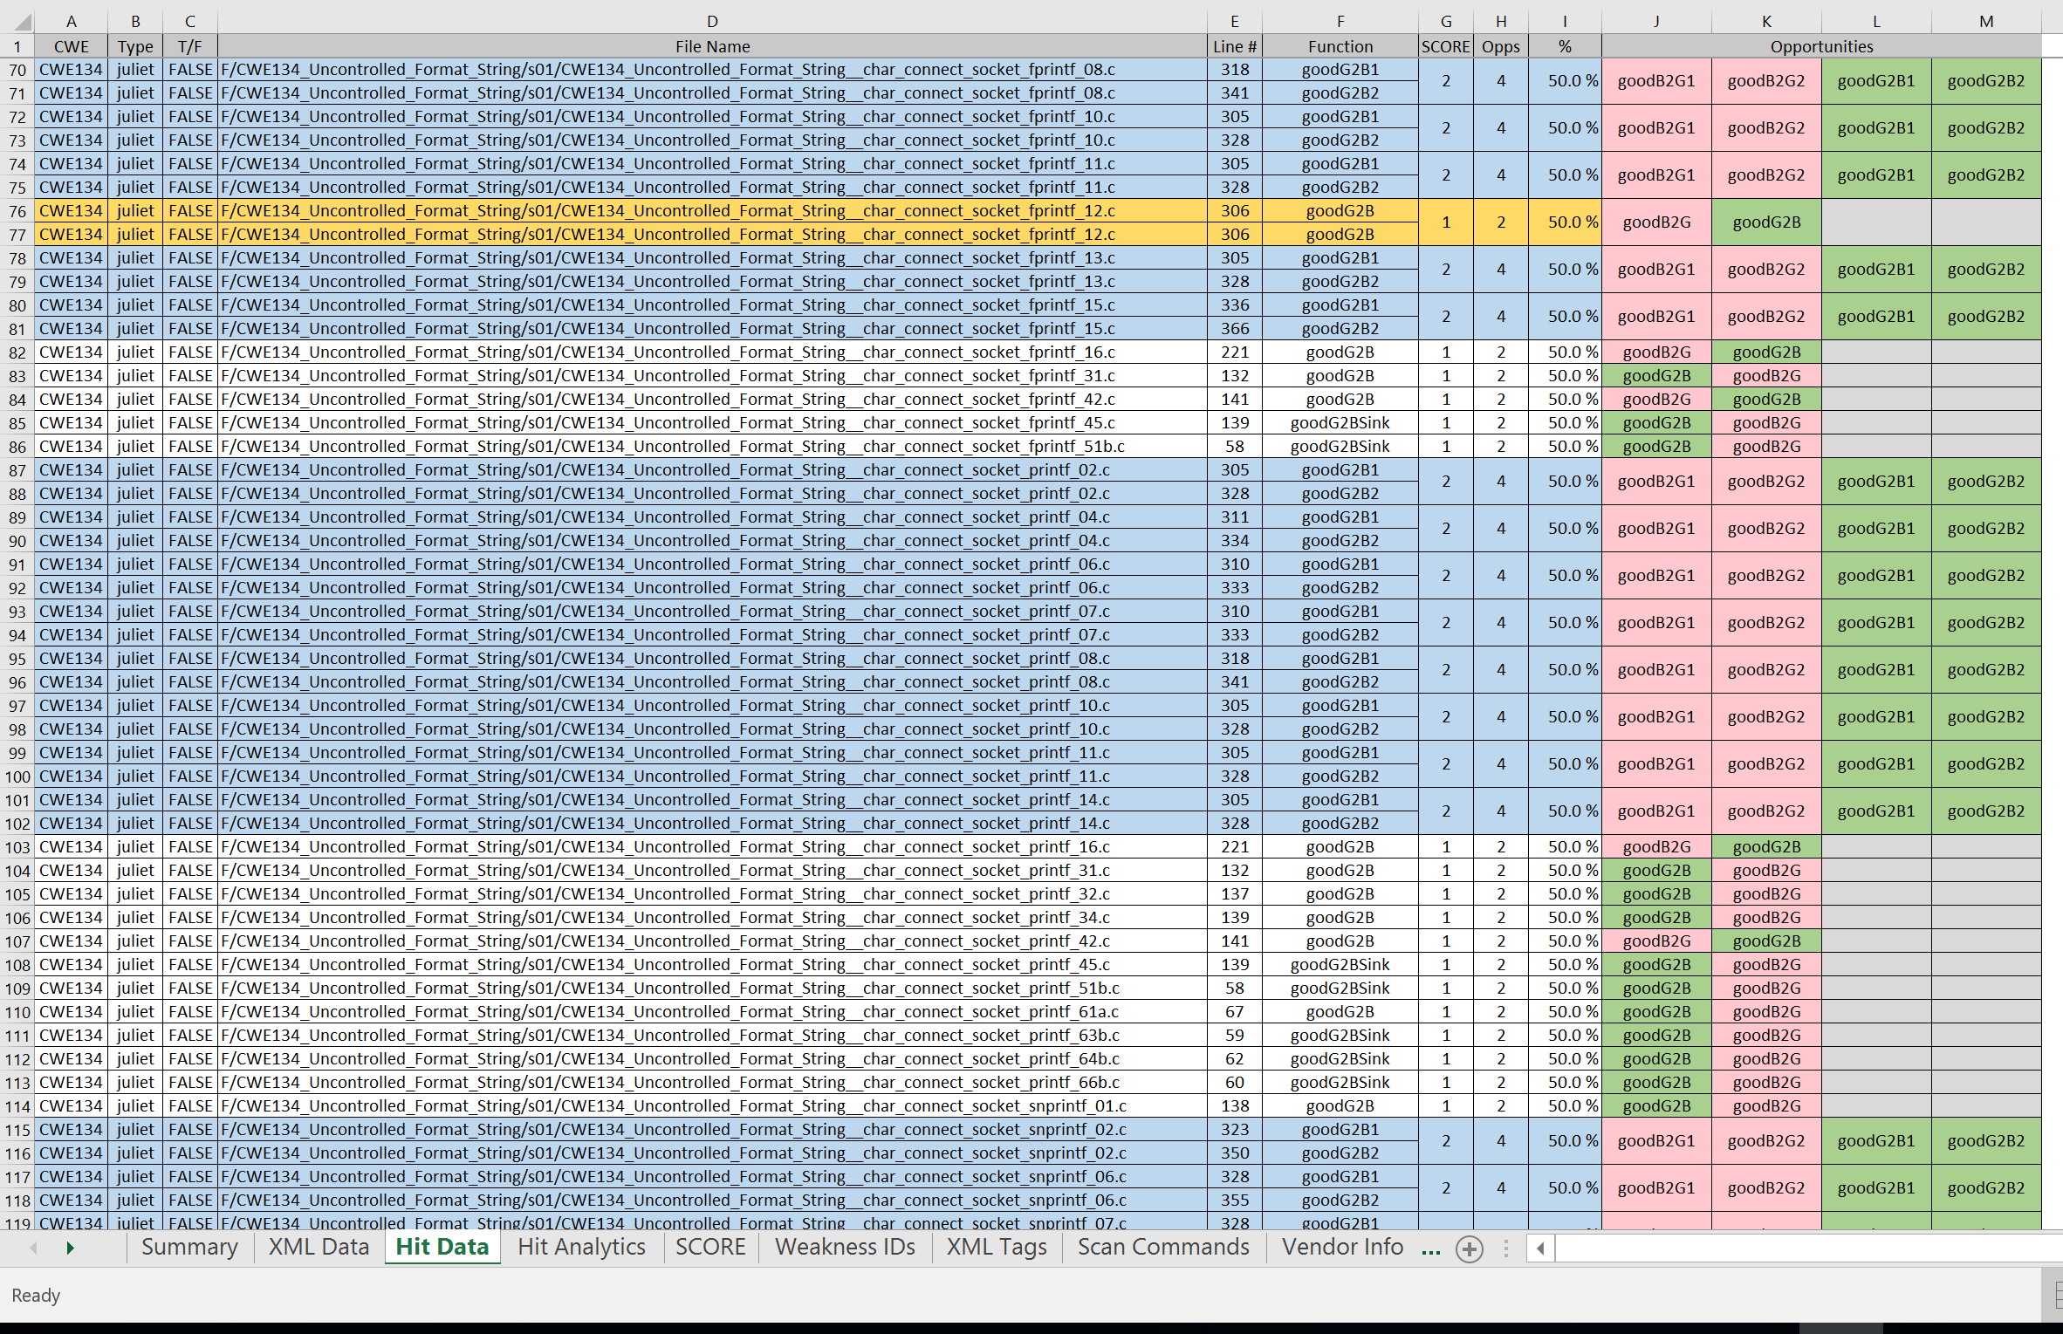
‘Hit Data’ Sheet (cont.)
Every hit for the entire suite is recorded in this sheet! The section displayed here focuses on the Juliet FALSE test cases and shows the opportunities available for each test case. The columns on the right show up to four ‘opportunities’ that encase the bait. The opportunities that ‘hit’ are represented in green otherwise they are red (un-hit). (Note: reversing colors in this section may be more intuitive)
Duplicate hits are identified by line number (and function) and de-duplicated if they repeat within the same opportunity
Items highlighted in yellow are exact duplicates having the same line number; they are only counted once
Items highlighted in blue represent multiple hits within the same file, but are unique and counted accordingly
All hits contribute to the ‘SCORE’. The number of hits per opportunity (‘Opps’) is the hit rate percentage (‘%’) .
In some rare cases, a hit may occur within an arbitrary ‘helper’ function such as ‘helperGood’. These are ambiguous and flagged for manual review and will have a status of “NEEDS REVIEW’ (none for this scan)

Slide 15
‘Hit Analytics’ Sheet

Slide 16
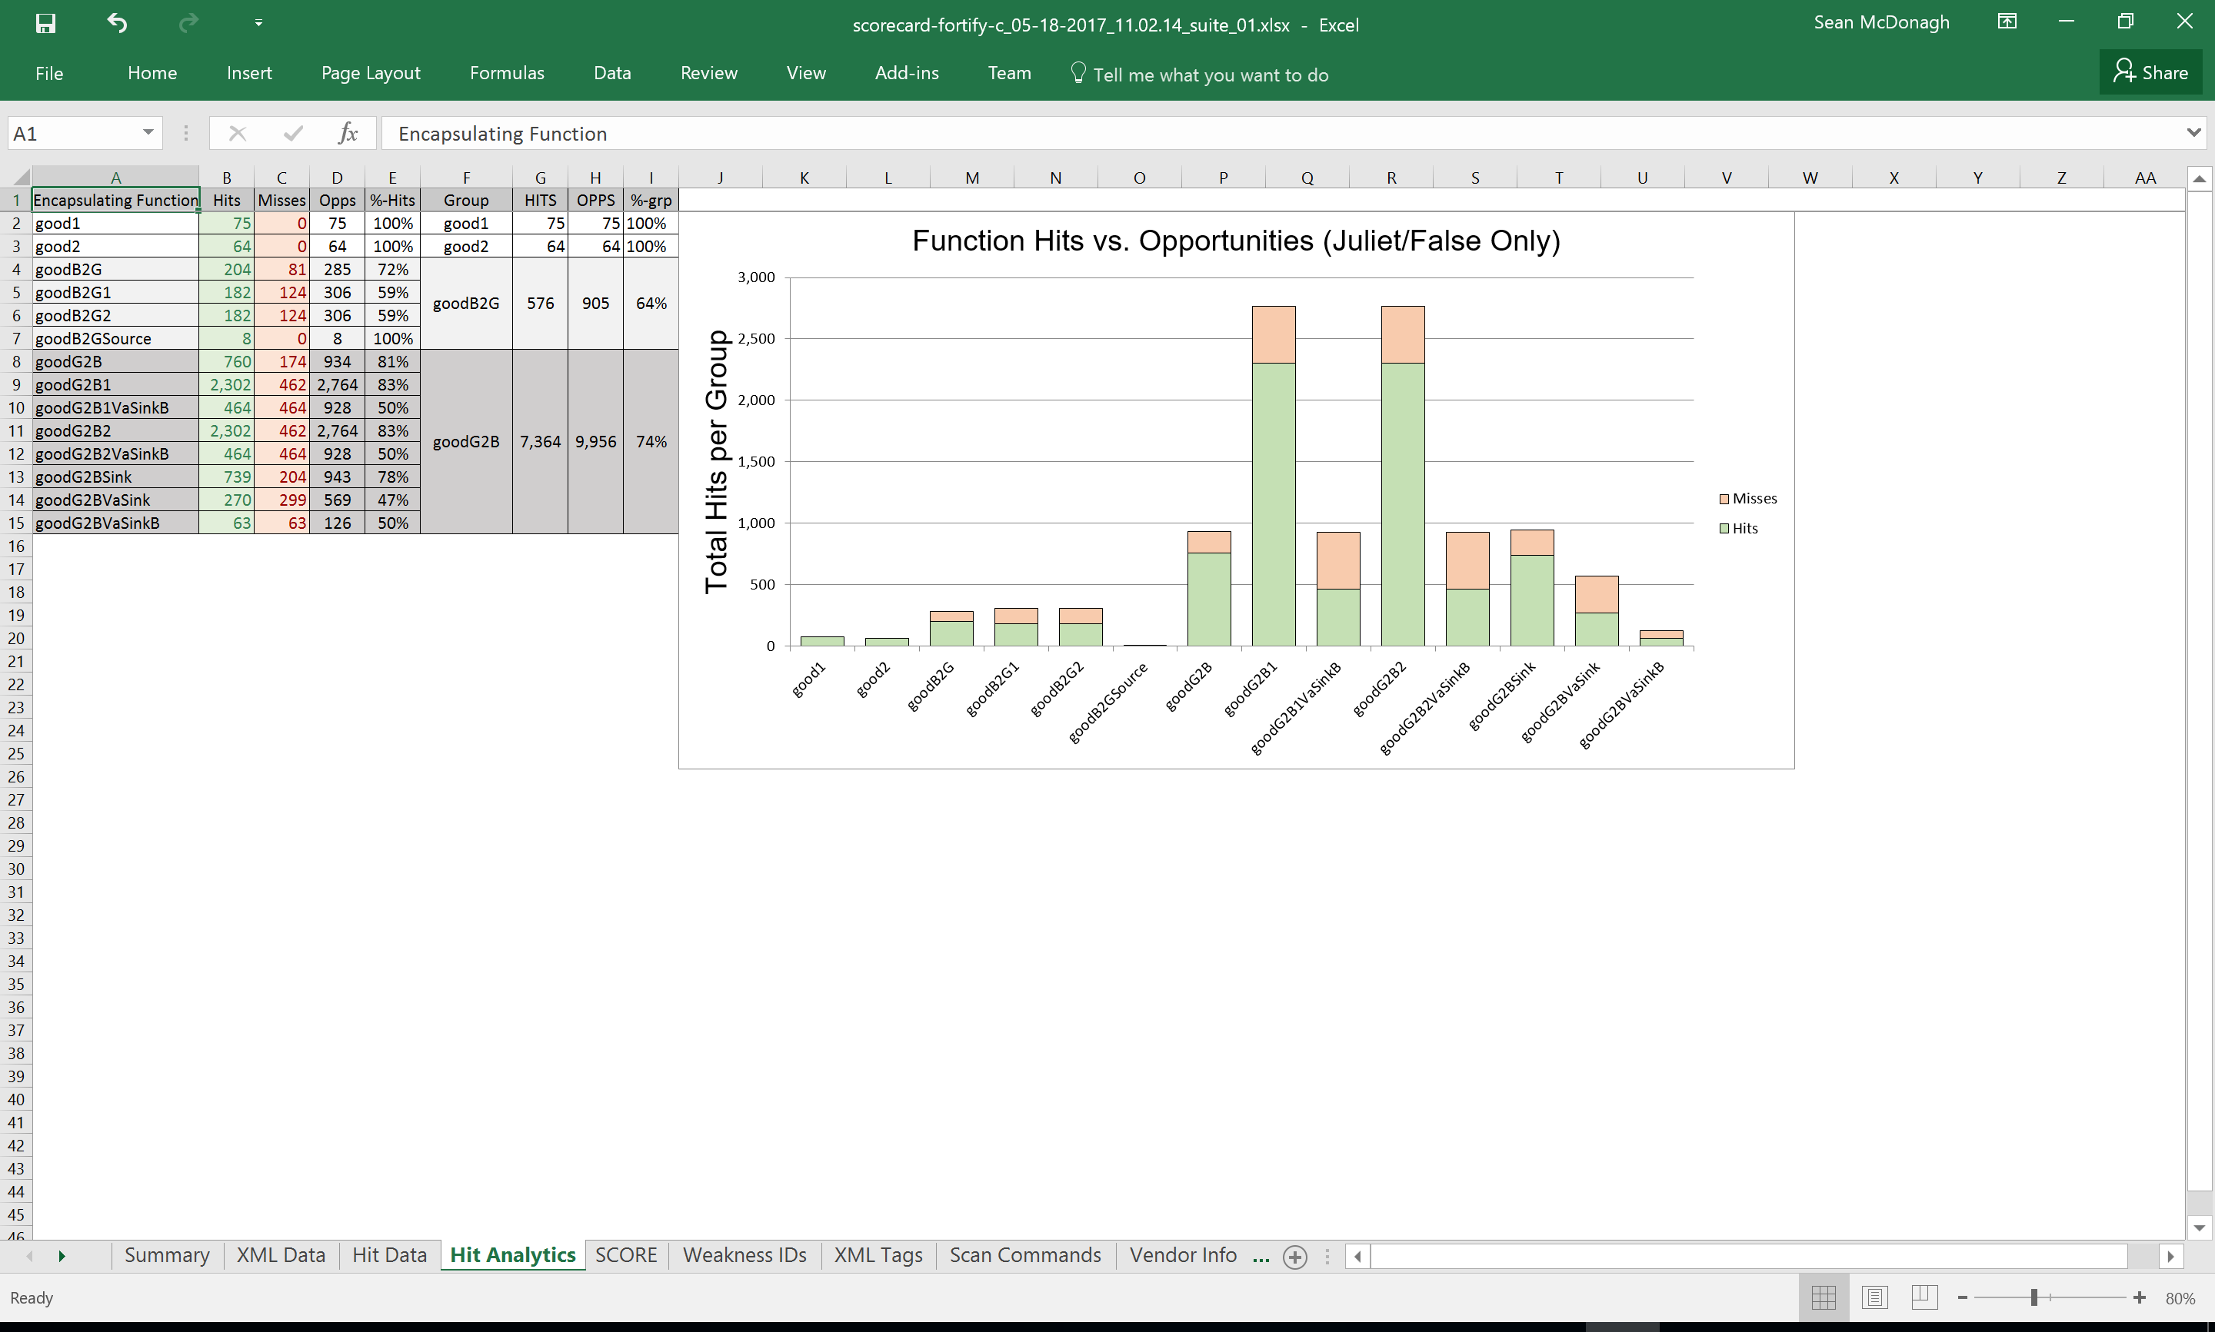

Slide 17
‘Hit Analytics’ Sheet (cont.)
This information is extracted from the ‘Hit Data’ and summarizes the overall ‘Hits’ & ‘Misses’ that occurred for each opportunity type (‘Encapsulating Function’).
This information may be useful for designing future test cases or could potentially be used by a vendor to improve their tool (Juliet/FALSE only)

Slide 18
‘SCORE’ Sheet

Slide 19
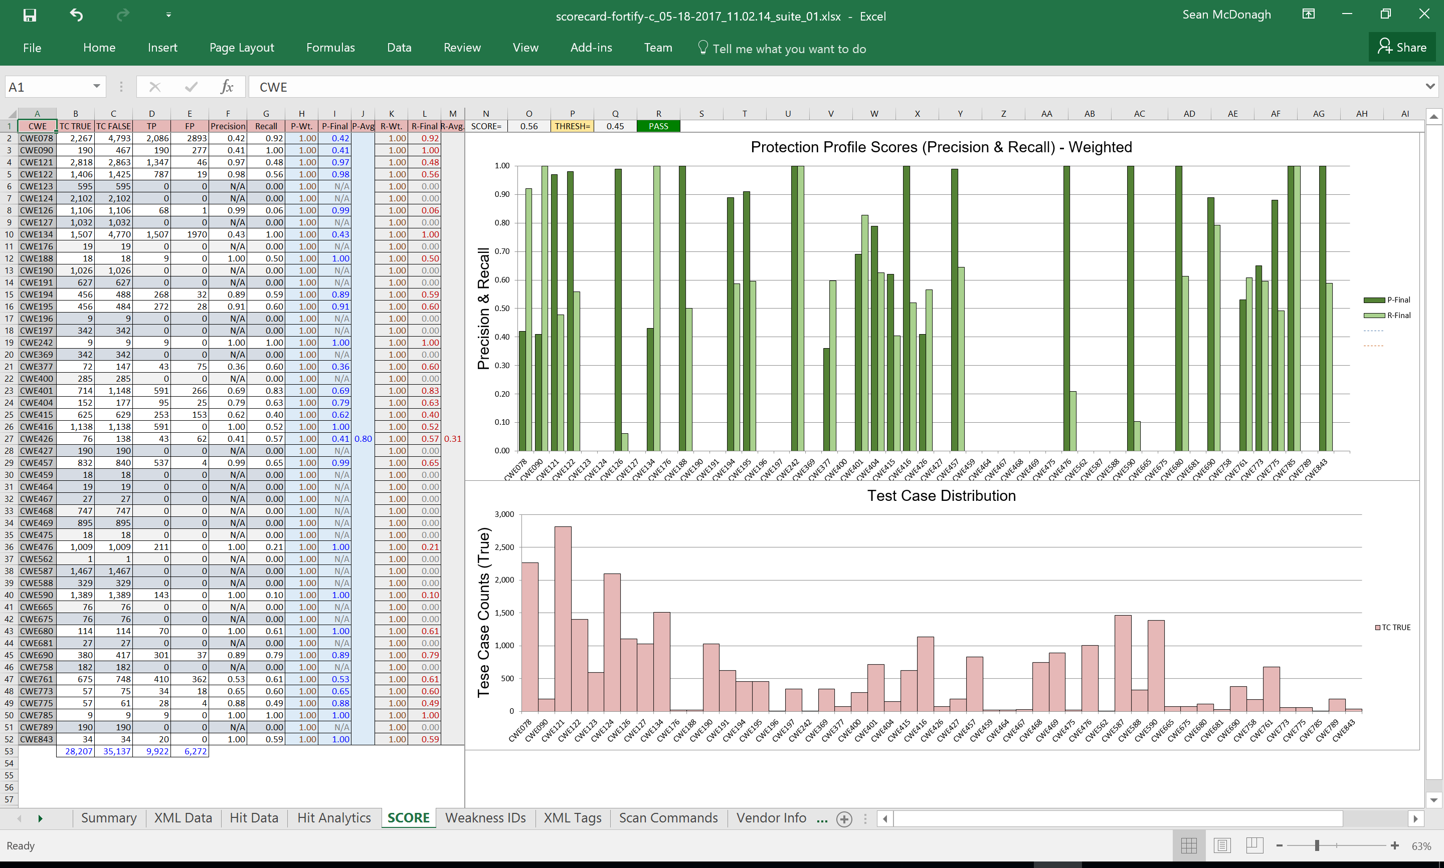

Slide 20
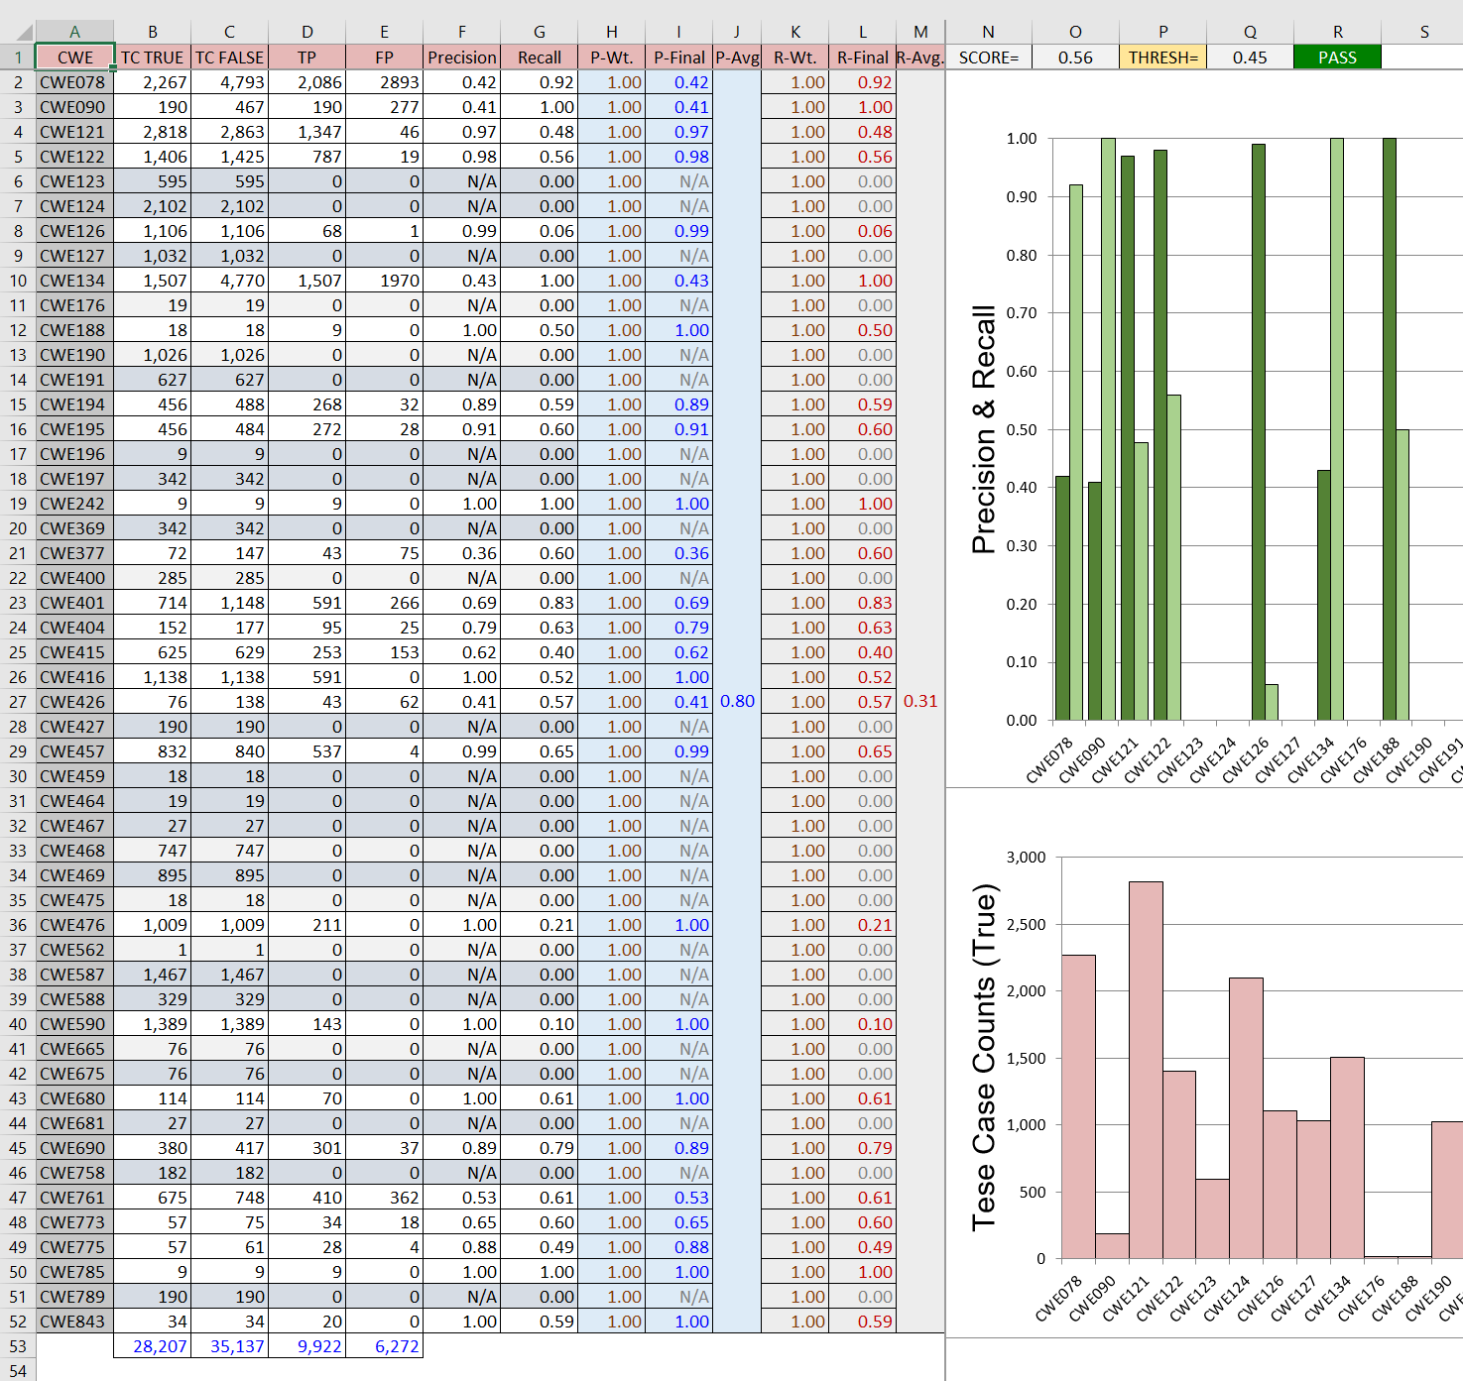
‘SCORE’ Sheet (cont.)
The information in this sheet may or may not be revealed to the vendor (A command-line argument could potentially hide/reveal this sheet if desired)
Currently, all weighting is set to 1.0 and all hits are treated equally. If weighting is to be applied, the new code has some of the hooks that could be used for this purpose
There are many approaches for weighting that could be implemented. Weighting could be assigned based on CWE, or by number of test cases per CWE (tiered-approach), etc. Previously, Juliet ‘base’ test cases were assigned ½ value and the remainder variants in that set received the other ½ value (divided equally). This gave the simplest flaw the most credit which is an interesting approach but one could argue that the more difficult test cases should receive more value
The average values for this suite simplify to Precision=0.80 and Recall=0.31. The overall score reflected in the title bar is ‘SCORE=0.56’ (the simple average of the ‘P-Avg.’ and ‘R-Avg.). Since it exceeds the arbitrary threshold of ‘THRESH=0.45’, it is considered to be a ‘PASS’. There are many questions to be answered such as do we average all CWEs or just those with hits, etc…
If this information is made available to the vendor, they will know their exact score and the threshold.
If some form of weighting is to be implemented, we will need to re-score the 10 suites to make sure their scores are relatively close to each other (this is relatively easy and quick to do)

Slide 21

‘SCORE’ Sheet (cont.)
The true ‘Weighted’ Precision and Recall results are displayed here.
Currently, the raw test case counts (TRUE) are shown for reference. If a tiered-approach to weighting is implemented, the thresholds would be presented graphically in the lower chart. If reordered, the overall profile of the test case counts is approximately a normal distribution which may help decide thresholds.

Slide 22
‘Weakness IDs’ Sheet

Slide 23
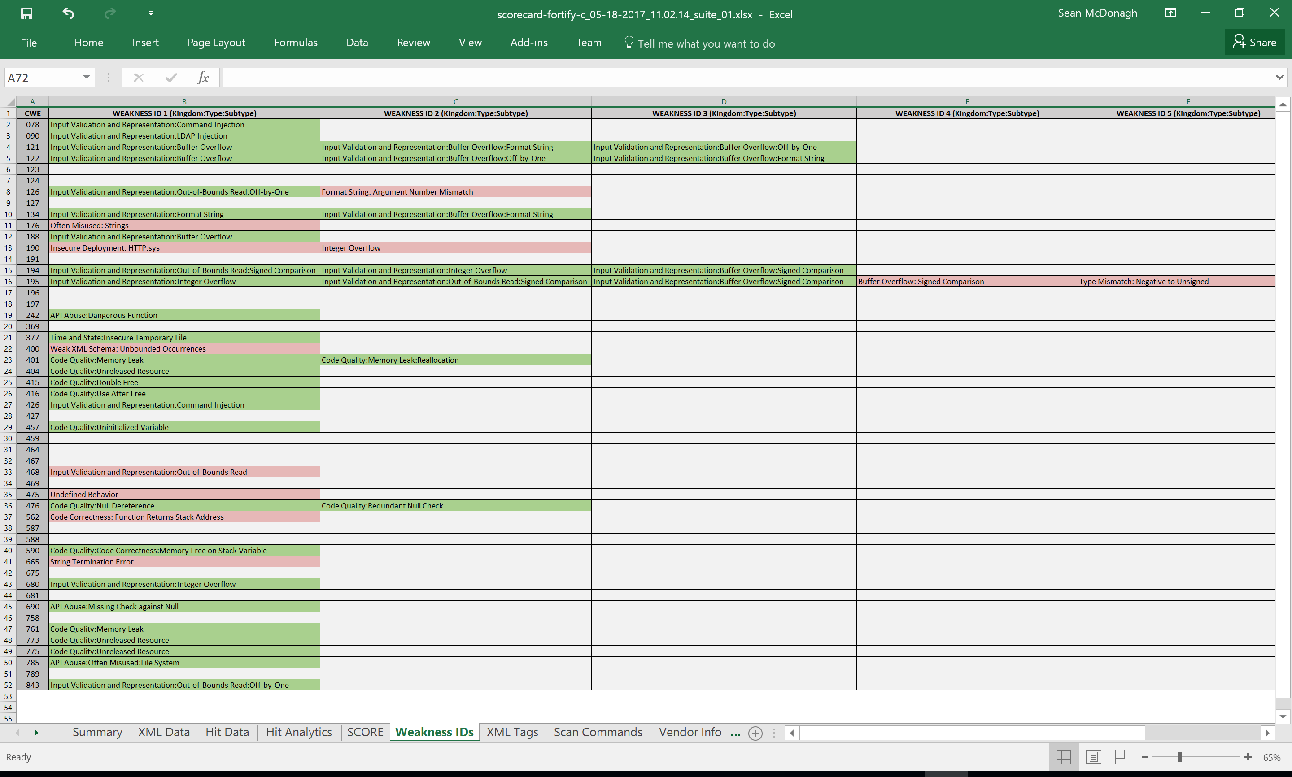
This is an exact replica of the Vendor Input form that the vendor provides. It contains the mapping of each valid rule to each CWE. The score.exe application identifies the used (green) and unused (red) Weakness IDs. The vendor may choose to use this information to improve their tool. This information can also be used to help design new test cases.

Slide 24
‘XML Tags’ Sheet

Slide 25
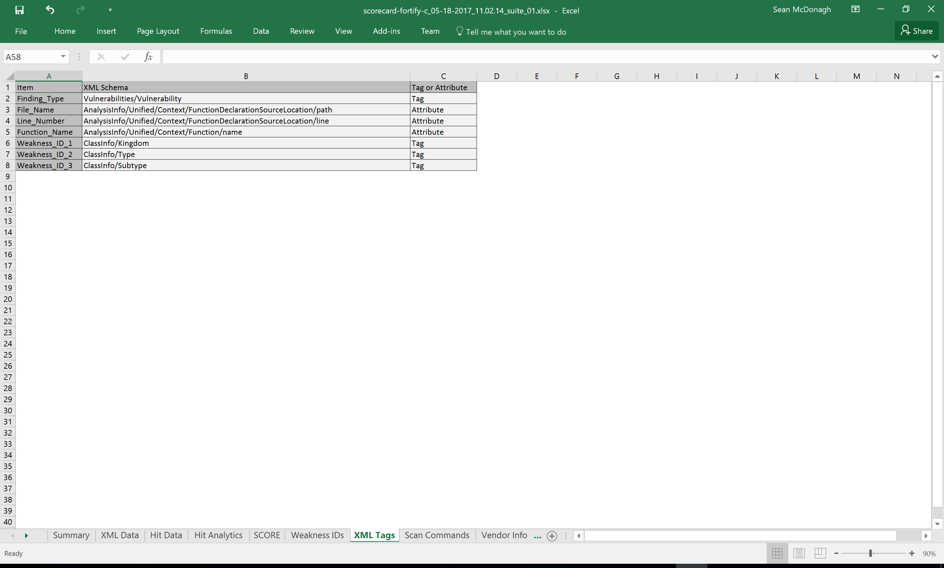
These are the XML Tags that are required to parse the XML data file produced by Fortify. Each tool has their own set of tags and they are not likely to change much between tool versions.
The ‘Line_Number’ and ‘Function_Name’ Items were added in v2.0 so that the unique opportunities in the Juliet FALSE test cases could be identified

Slide 26
‘Scan Commands’ Sheet

Slide 27
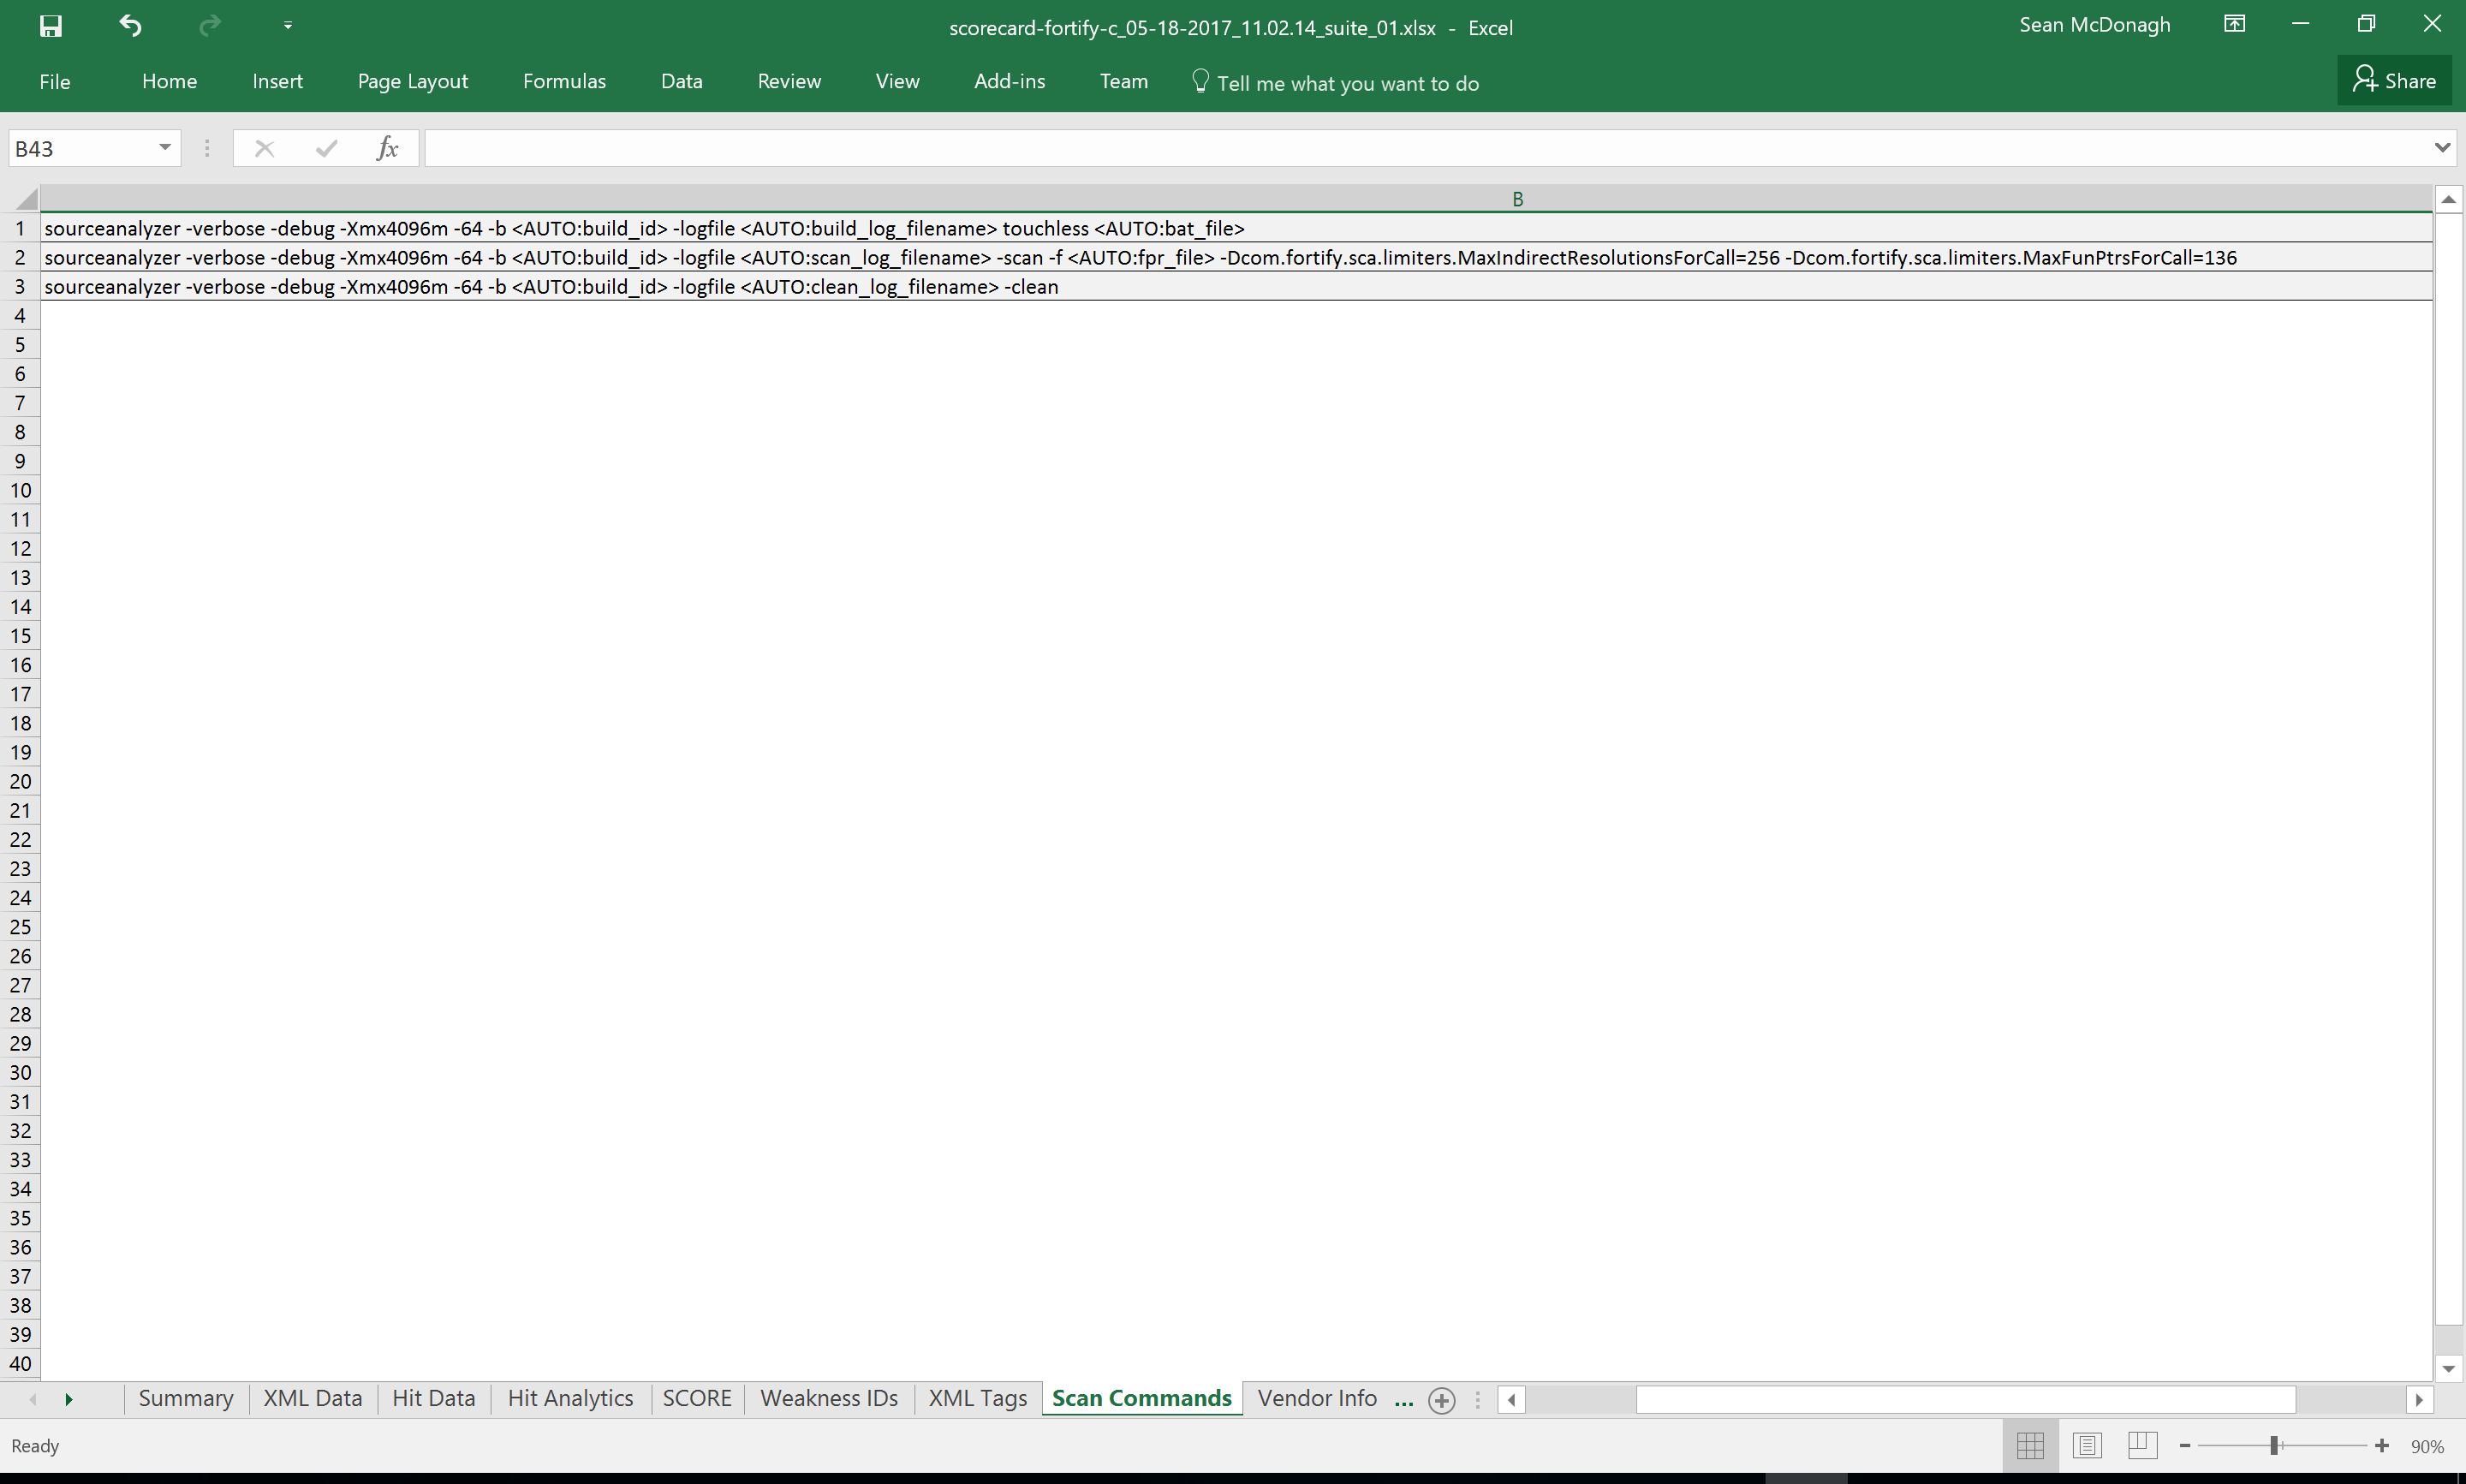
This sheet contains the commands to run the scan externally without the Python script. No changes were necessary in this sheet for v2.0

Slide 28
‘Vendor Info’ Sheet

Slide 29
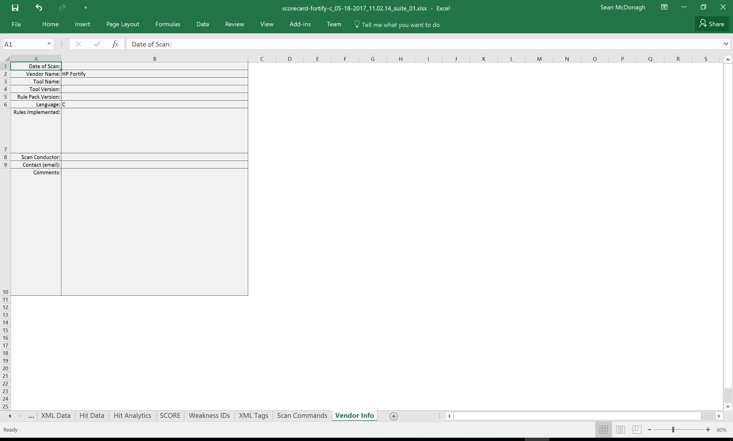
This sheet contains information provided by the vendor. All information in this sheet is copied directly to the scorecard and becomes a part of the permanent record.

Slide 30
Summary, To Do …
The auto-scorer ‘score.exe’ v2.0 is considered to be a pre-release; it has been tested against Suite 01 (C-Language) but needs to be validated against:
Other suites (02->10)
C++
Java
SCA tools other than Fortify
A weighting algorithm, if any, needs to be determined
A pass/fail threshold needs to be determined
Vendor disclosures need to be identified; do we want them to have all of the score card sheets or do we conceal some of them?

